Slide 1
JED EDITOR
May 2011
Notes:
© 2006 Capgemini - All rights reserved
0

Slide 2
What You Will Learn In This Session
At the end of the session you will have
Adequate knowledge to understand
The JED editor
Commonly used JED Editor commands
Navigation at the jsh prompt
Notes:
Trainee notes

Slide 3
JED Editor – An Introduction
Page Editor
Terminal independent
Two types of commands
Command Line
Text Line

Slide 4
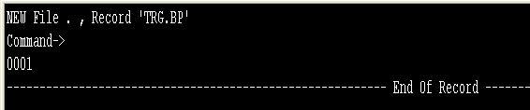
Creating A record Using JED
JED <file name> <record id>
jsh….>JED TRG.BP FILE1
Command Line
Text Line

Slide 5
Navigation From Command Line To Text Line And Vice Versa
Command line to text line
Command line command : <line number>
Text line to command line
Text line command : Esc

Slide 6
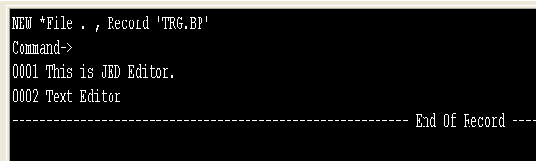
Typing Data
Enter - To get to the next line
- Previous Line
- Next Line
- Move to the next char
- Move to the previous char
Backspace - Delete a character

Slide 7
Command Line Commands
Go to a particular line
<Line Number>
Go to the last line
<Last line number> or
A huge number such as 999999
Exit without saving
EX
EXIT
Ctrl X
Save and exit
FI
Save and remain in the editor
FS

Slide 8
Command Line Commands
Delete current line
DE
Delete next 5 lines
DE5
Replace first occurrence of a word in the current line
R/<String to be replaced>/<Sting to replace>
Replace first 3 occurrences of a word in the current line
R/<String to be replaced>/<Sting to replace>/3
Replace all occurrences on the current line
RU/<String to be replaced>/<Sting to replace>
Replace first occurrences on next 3 lines
R3/<String to be replaced>/<Sting to replace>
Replace all occurrences on next 3 lines
RU3/<String to be replaced>/<Sting to replace>

Slide 9
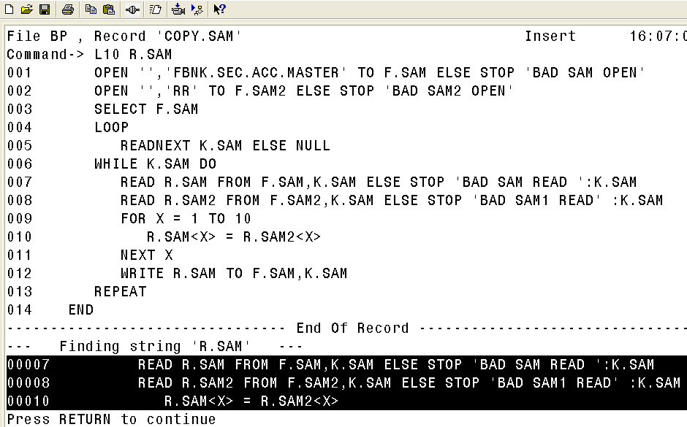
Command Line Commands
Locate a string
L <String>
Repeat Locate On Next nn Lines
Lnn <String>

Slide 10
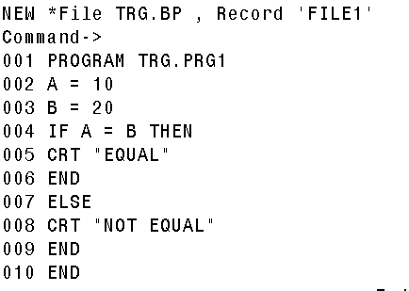
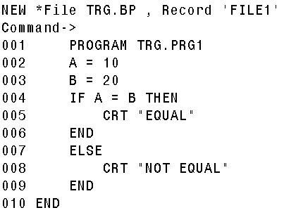
Format Code
Command Line Command - BI
Text Line Command - Ctrl + V
Before After

Slide 11
Text Line Commands
Move to beginning of a line
Ctrl A
Move to end of a line
Ctrl E
Delete a word
Ctrl W
Delete from the current position to end of the line
Ctrl K
Delete a line
Ctrl DD
Insert line below the current line
Ctrl L

Slide 12
Text Line Commands
Repeat locate
Ctrl N
Used after ‘L <string’ is executed from the command line
Toggle between insert and overwrite
Ctrl O
Redisplay the screen
Ctrl R
Copy from the line above
Ctrl T

Slide 13
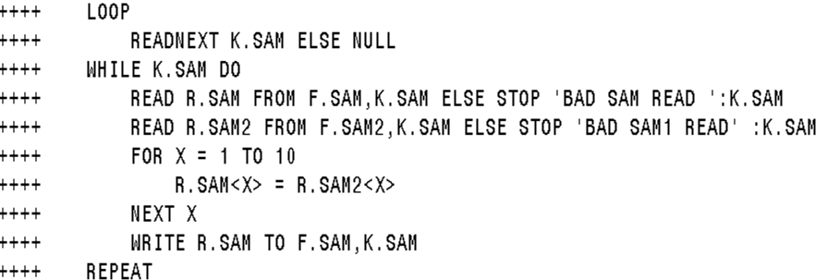
Text Line Commands - Defining Blocks
Ctrl G – Defines Start and End of Block

Slide 14
Text Line Commands – Block Manipulation Commands
Copy after current
CA
Copy before
CB
Move after
MA
Move before
MB
Delete block
DB
Once the block is defined, place the cursor on a line of your choice and then execute any of the commands listed above

Slide 15
Text Line Commands – Block Manipulation Commands
Copy after current line n times
CAn
Copy before current line n times
CBn

Slide 16
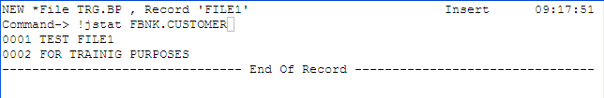
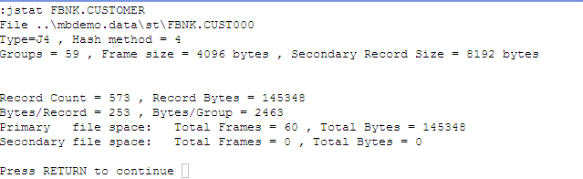
Execute jBASE/OS Command From Within The JED Editor
Command Line Command
Can execute any valid jBASE / OS command
Syntax : !command

Slide 17
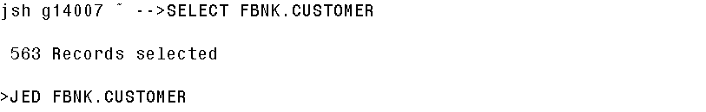
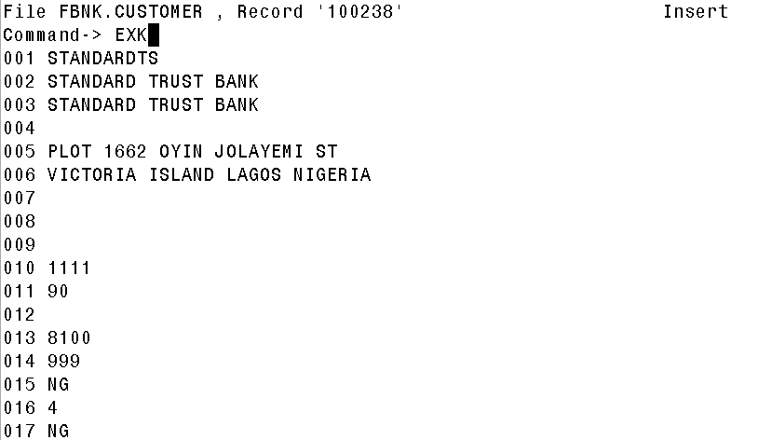
Exiting From Select Lists

Slide 18
Navigation At The jsh Prompt
Move to beginning of a line
Ctrl A
Move to end of a line
Ctrl E
Delete a word
Ctrl W
Delete from the current position to end of the line
Ctrl K
Toggle between insert and overwrite
Ctrl O

Slide 19
Summary
jED is an editing tool available with jBASE.
Commands can be execueted at
Command Line
Text Line

Slide 20


www.capgemini.com/financialservices

